Slide 1
Diseases of nasopharynx
Dr S Jaya Sandeep

Slide 2
introduction
Nasopharynx is a connecting link between
nasal cavity and oropharynx and is
lined by pseudostratified squamous epithelium
and has rigid walls.
Height- 4 cm.
Width- 4 cm.
Anteroposteriorly- 3 cm.

Slide 3
communications
Anteriorly: Posterior choanae and posterior part of nasal septum.
Floor: It is formed by soft palate and a part of hard palate.
Roof: It is slopy and is formed by basisphenoid, basiocciput and outer aspects of C1 and C2 vertebrae and these contributes to form the posterior wall also.

Slide 4
communications
Posteriorly: It communicates with oropharynx and is guarded by a ring, known as Passavant’s ring, which has a sphincteric action and is a fibromuscular band which prevents the regurgitation of fluids from oropharynx to nasopharynx.
Laterally: It communicates with the middle ear cavity via eustachian tube. The nasopharyngeal orifice of eustachian tube has a pad of fat known as Ostman’s pad of fat, which in malnourished children atrophies and leads to patulous eustachian tube predisposing to recurrent middle ear infections.

Slide 5
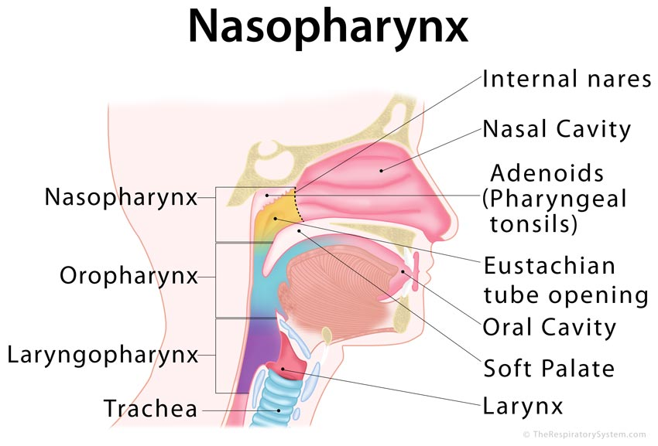

Slide 6
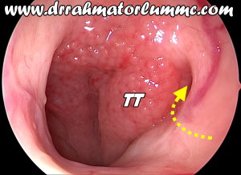

Slide 7
Blood Supply
The main blood supply is from branches of external carotid artery.
Ascending palatine artery
Tonsillar artery (branch of facial artery)
Ascending pharyngeal artery (branch of external carotid artery)
Dorsal lingual branches of the lingual artery.
The venous plexus drains into pterygoid plexus of veins and into internal jugular vein

Slide 8
lymphatic drainage
Nasopharynx houses a pad of lymphoid tissue at the roof, known as nasopharyngeal tonsil.
Pathologically, enlarged nasopharyngeal tonsil is known as adenoids.
The lymphatic drainage is to retropharyngeal and upper deep cervical lymph nodes.

Slide 9
Sinus of Morgagni
It is a large gap between the upper border of superior constrictor muscle and the base of skull.
It is the sinus present in lateral wall of nasopharynx near the torus tubaris through which eustachian tube, levator palati muscle and ascending palatine artery gain access to the nasopharynx.

Slide 10
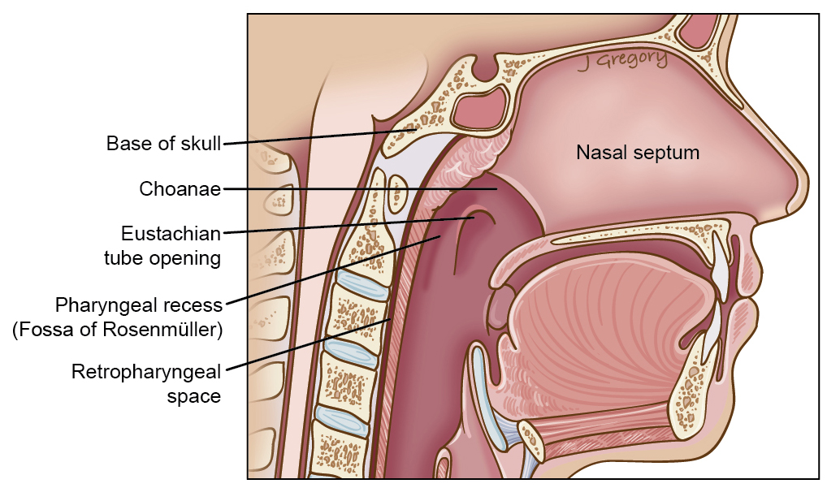
Fossa of Rosenmuller
It is a 1.5 cm deep cleft behind and above the torus tubaris.
It is the commonest site of nasopharyngeal carcinoma.

Slide 11
EXAMINATION
1. Digital palpation
2. Posterior rhinoscopy
3. Radiological studies: X-ray studies, CT scan and MRI.
4. Fibreoptic nasopharyngoscopy

Slide 12
Congenital
Meningioma
Craniopharyngioma
Dermoid cyst
Thornwaldt’s bursa
Teratoma
Haemangioma
Lymphangioma
Chondroma
Chordoma.

Slide 13
Adenoiditis
AETIOLOGY
Adenoids are subject to physiological enlargement in childhood.
Recurrent attacks of rhinitis, sinusitis or chronic tonsillitis may cause chronic adenoid infection and hyperplasia.
Allergy of the upper respiratory tract may also contribute to the enlargement of adenoids.

Slide 14
CLINICAL FEATURES
1. Nasal Symptoms : Nasal obstruction, Nasal discharge, Sinusitis, Epistaxis, Voice change.
2. Aural Symptoms : Tubal obstruction, Recurrent attacks of acute otitis media, Chronic suppurative otitis media, Otitis media with effusion.
3. General Symptoms : Adenoid facies, Pulmonary hypertension.

Slide 15
Adenoid facies

Slide 16
ACUTE NASOPHARYNGITIS
Acute infection of the nasopharynx may be an isolated infection confined to this part only or be a part of the generalized upper airway infection.
It may be caused by viruses (common cold, influenza, parainfluenza, rhino or adenovirus) or bacteria (especially streptococcus, pneumococcus or Haemophilus influenzae).

Slide 17
CLINICAL FEATURES
Dryness and burning of the throat above the soft palate is usually the first symptom, followed by pain and discomfort, difficulty on swallowing. In severe infections, there is pyrexia and cervical lymph nodes.
Examination of nasopharynx reveals congested and swollen mucosa often covered with whitish exudate.

Slide 18
CHRONIC NASOPHARYNGITIS
It is often associated with chronic infections of nose, paranasal sinuses and pharynx. It is commonly seen in heavy smokers, drinkers and those exposed to dust and fumes.
CLINICAL FEATURES: Postnasal discharge and crusting with irritation at the back of nose is the most common complaint.
Examination of nasopharynx reveals congested mucosa and mucopus or dry crusts. In children, adenoids are often enlarged and infected (chronic adenoiditis).

Slide 19
THORNWALDT’S DISEASE
Also known as PHARYNGEAL BURSITIS.
It is infection of the pharyngeal bursa which is a median recess representing attachment of notochord to endoderm of the primitive pharynx.
Pharyngeal bursa is located in the midline of posterior wall of the nasopharynx in the adenoid mass.

Slide 20
CLINICAL FEATURES
1. Persistent postnasal discharge with crusting in the nasopharynx.
2. Nasal obstruction due to swelling in the nasopharynx.
3. Obstruction to eustachian tube and serous otitis media.
4. Dull type of occipital headache.
5. Recurrent sore throat.
6. Low-grade fever

Slide 21
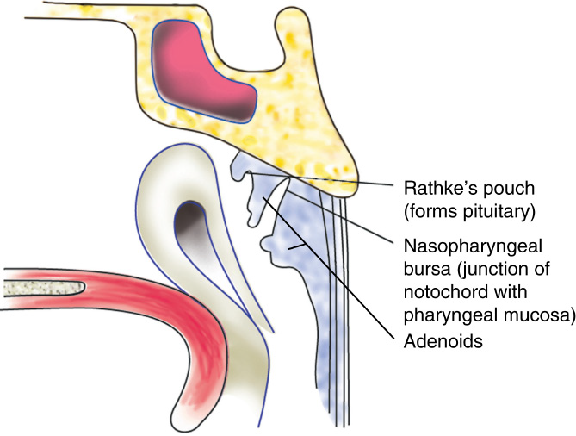
Examination would reveal a cystic and fluctuant swelling in the posterior wall of nasopharynx. It may also show crusts in the nasopharynx due to dried up discharge.

Slide 22
Rathke’s Pouch
It is represented clinically by a dimple above the adenoids and is reminiscent of the buccal mucosal invagination, to form the anterior lobe of pituitary. A craniopharyngioma may arise from it.

Slide 23
Thank you

